Slide 1
Mixed waste dumping in Belhalli quarry pits, Bangalore
Almitra H Patel
Member, Supreme Court Committee for Solid Waste Management in Class 1 Cities
11 May 2016
almitrapatel@rediffmail.com
www.almitrapatel.com

Slide 2
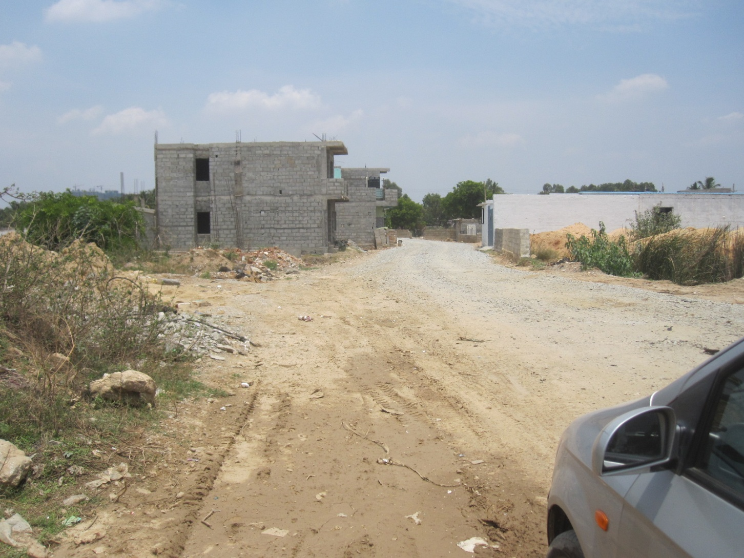
Bangalore’s Belhalli quarry is approached by a newly metalled road

Slide 3
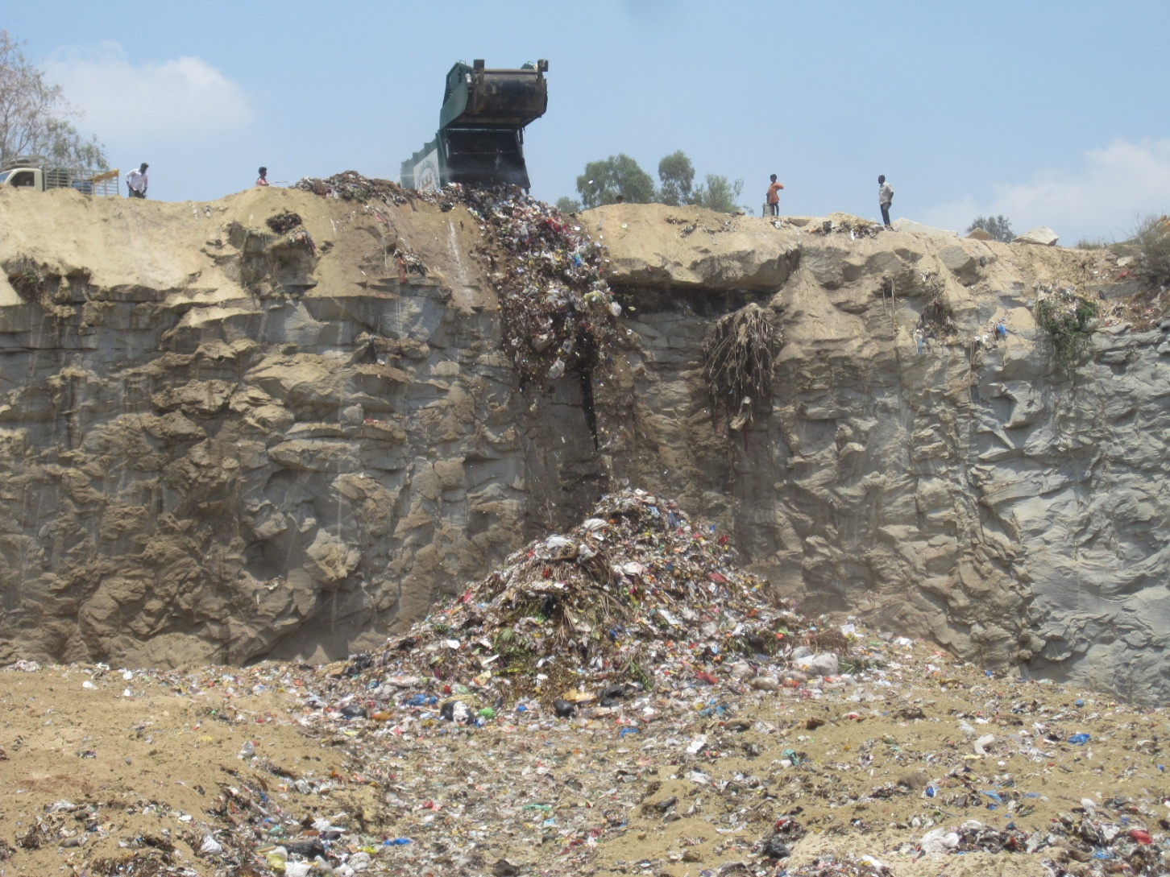
so that compactors can unload mixed waste into an unlined quarry, permanently polluting groundwater for decades !

Slide 4
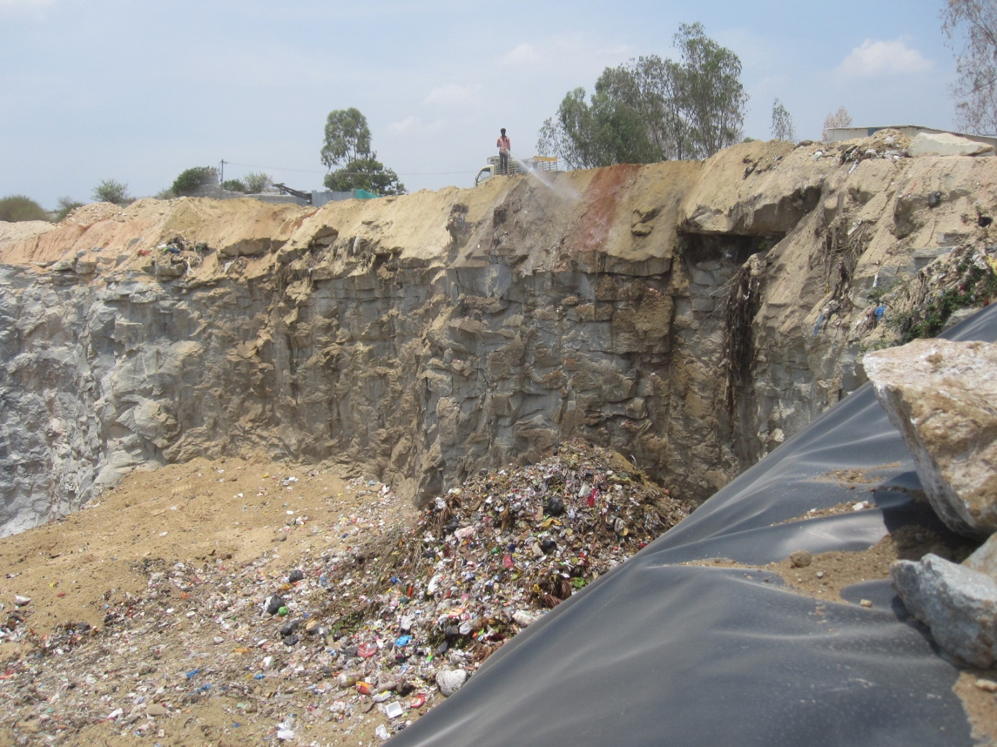
With mixed waste dumped on an unlined floor, the quarry is being partly lined

Slide 5
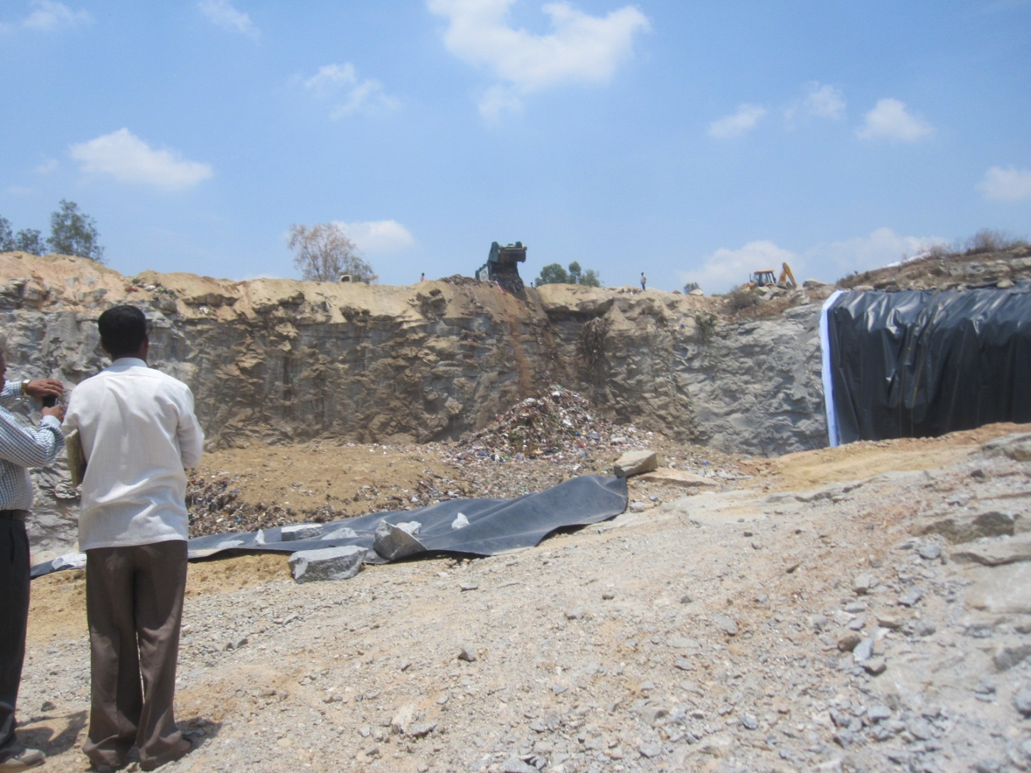
The quarry is being partly lined with porous white fabric

Slide 6
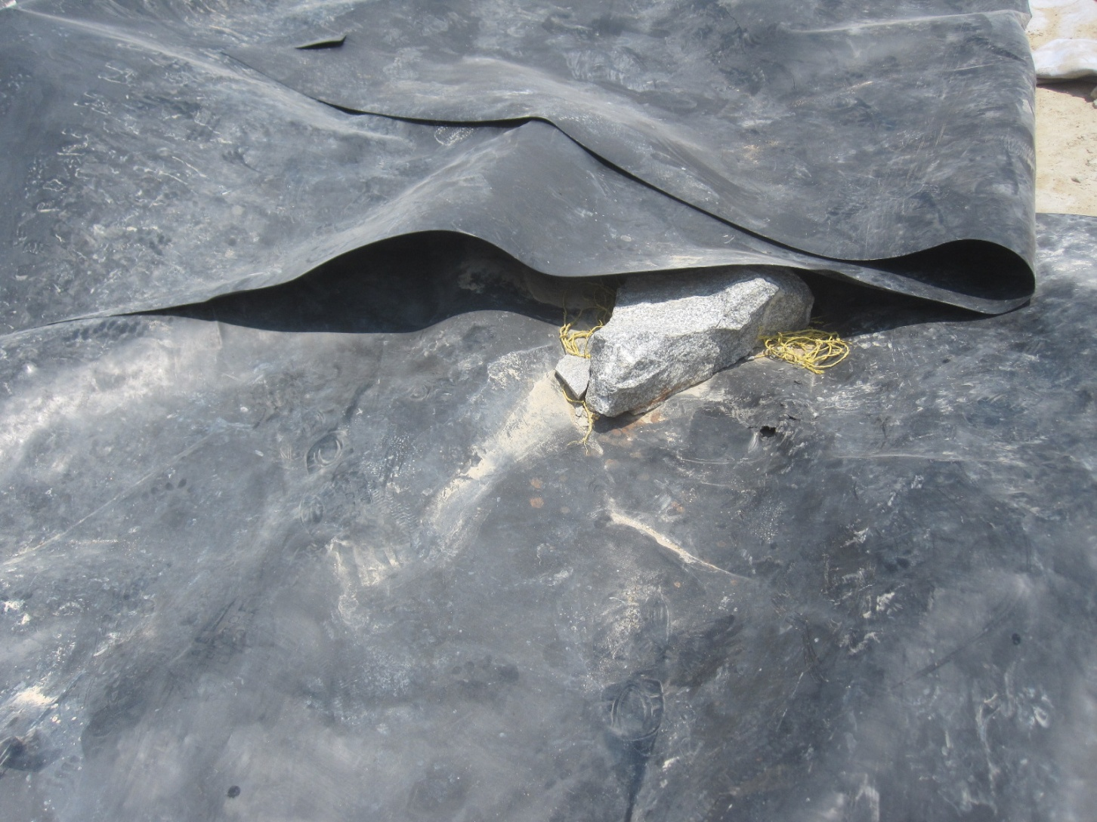
Covered with overlapping black plastic without waterproof welded seams

Slide 7
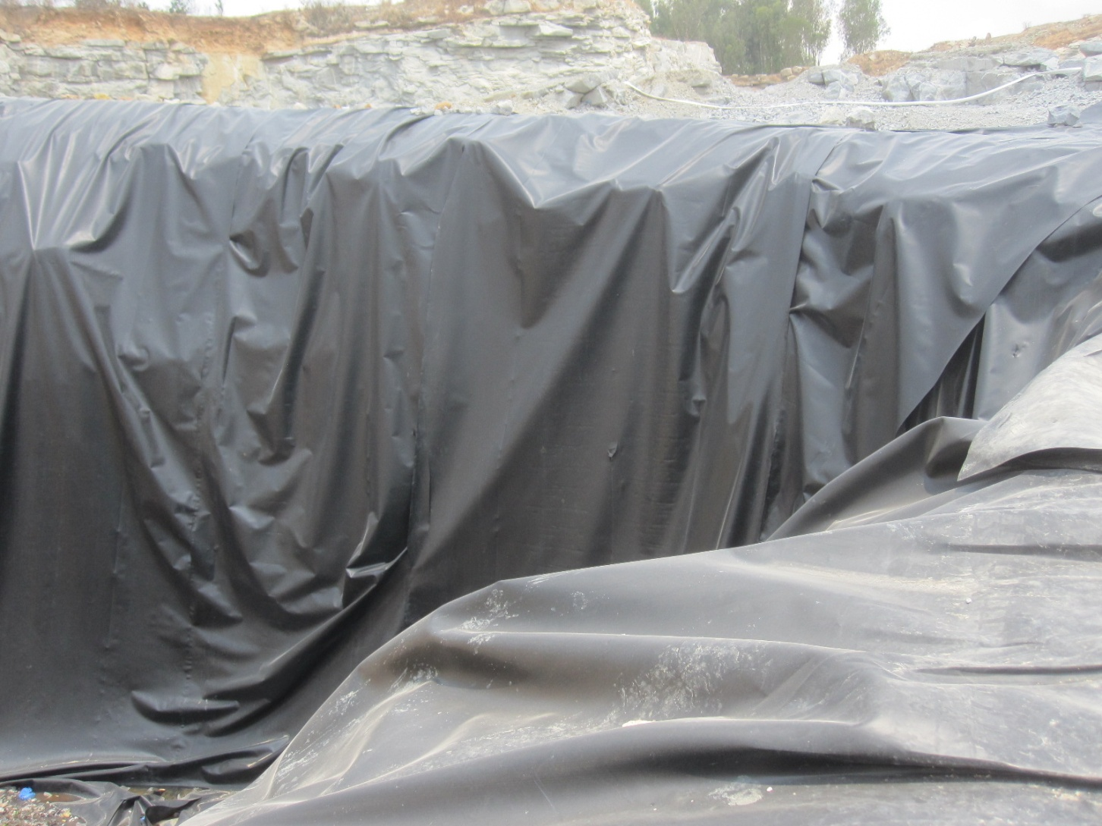
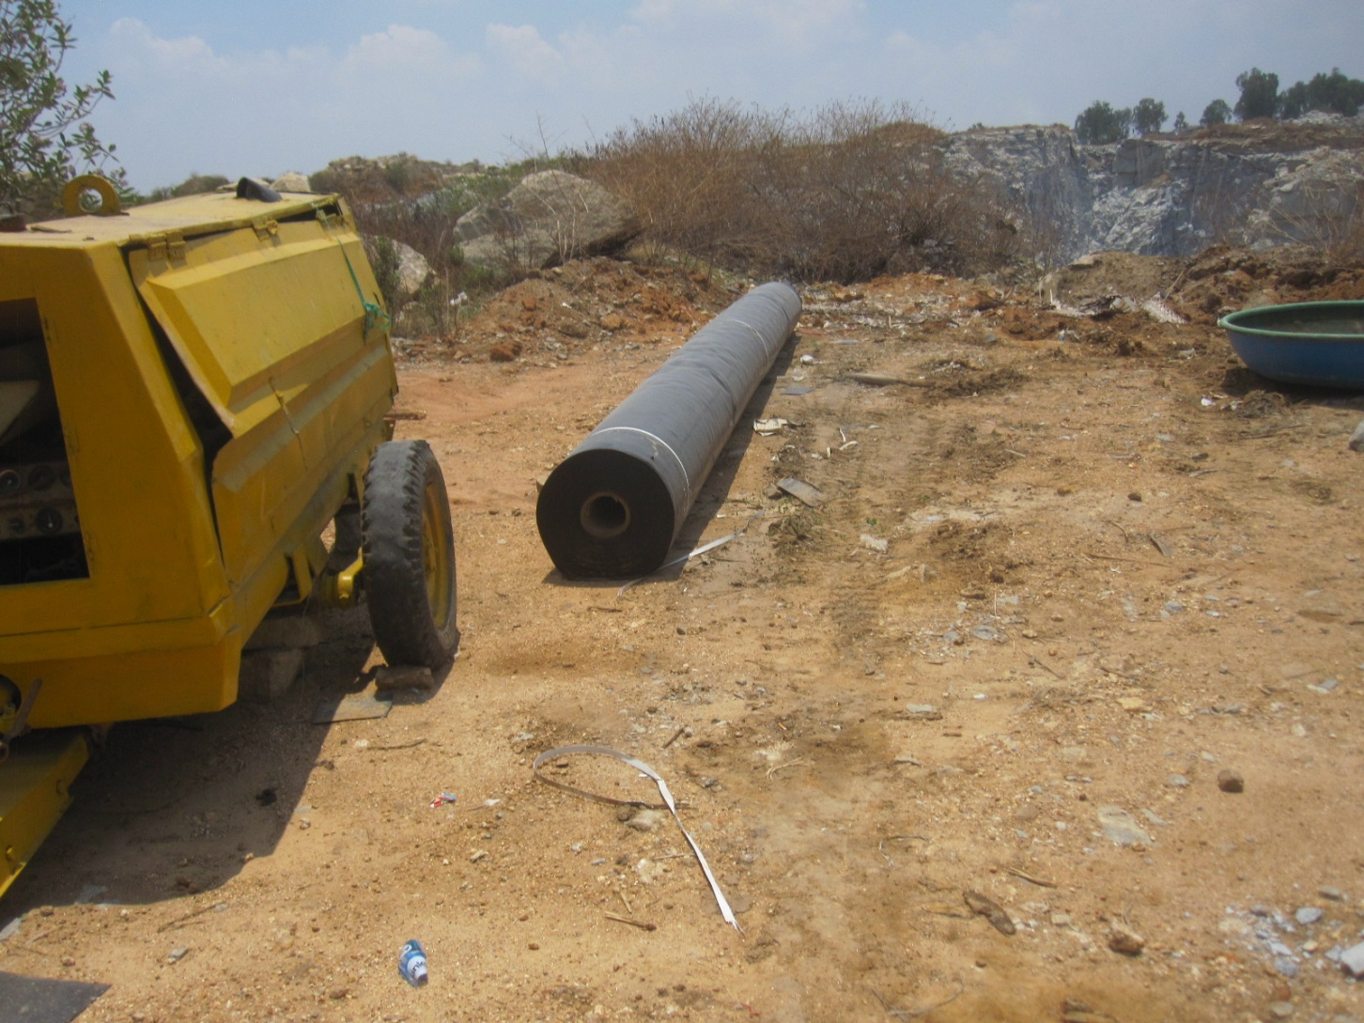
The plastic rolls are draped over the edge of the quarrypit

Slide 8
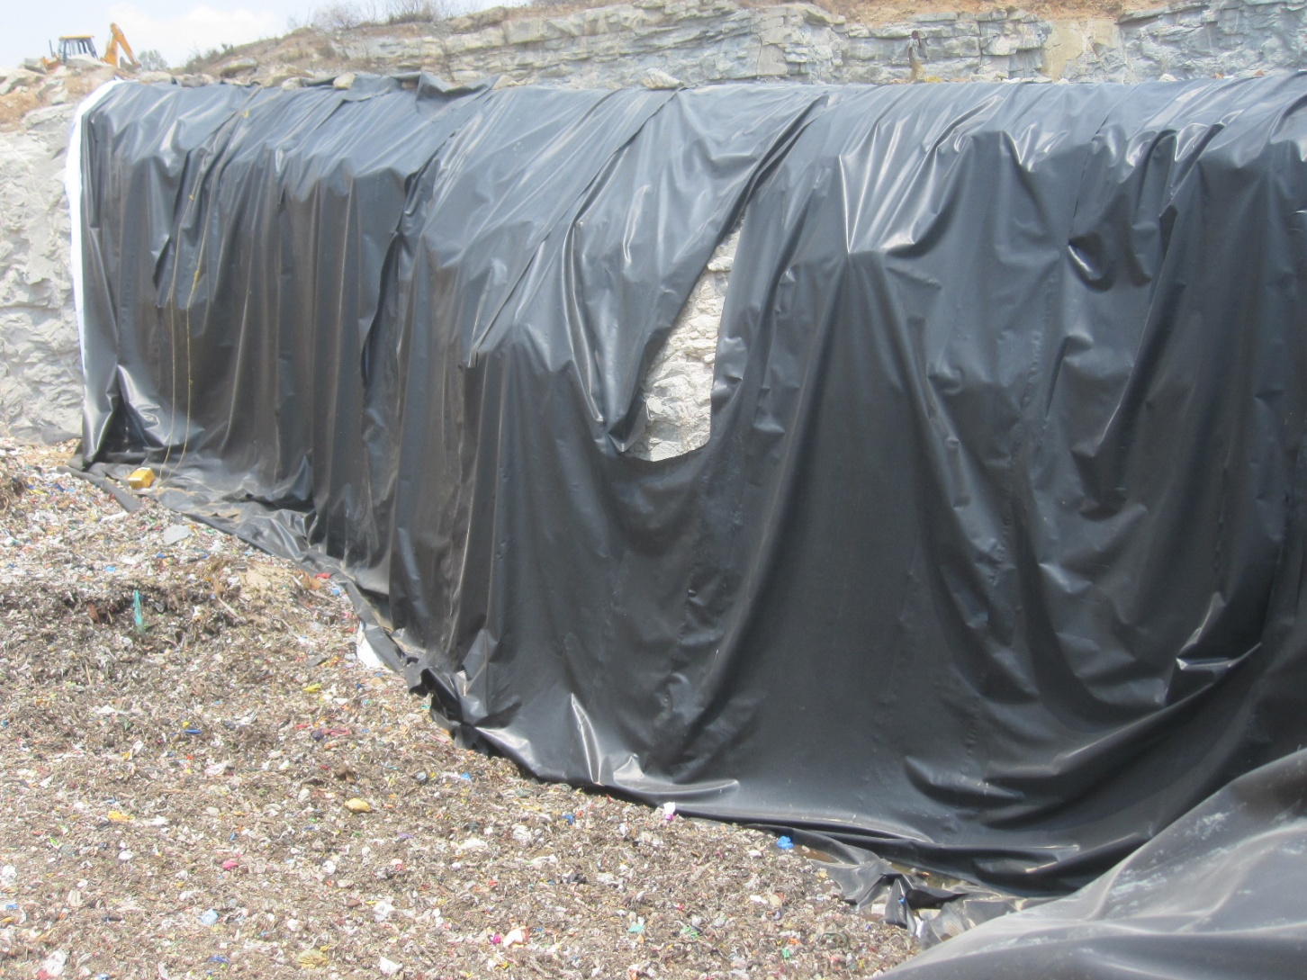
In token fashion without proper overlap.

Slide 9
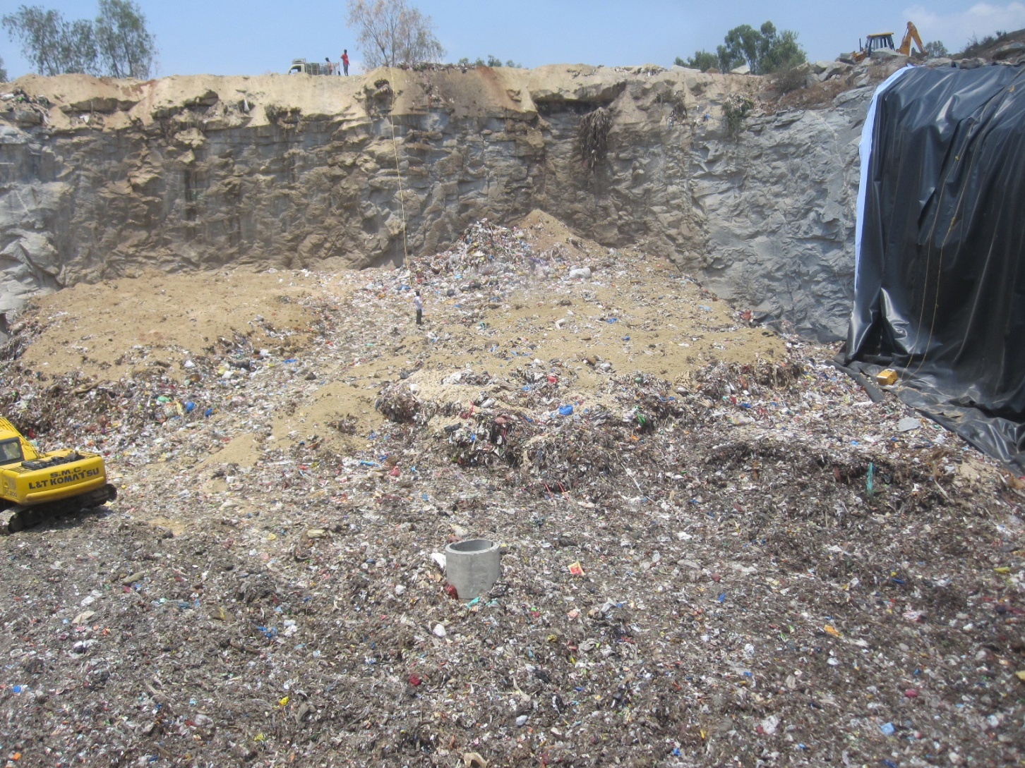
Mixed waste spread on the unlined quarry floor is covered with soil which serves no purpose.

Slide 10
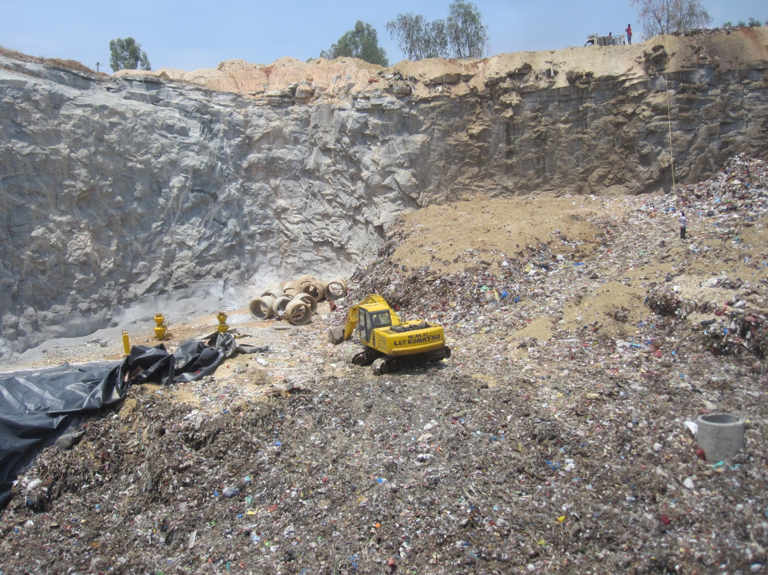
Using coarse organics as cover would help compost the dumped waste and make later biomining easier.

Slide 11
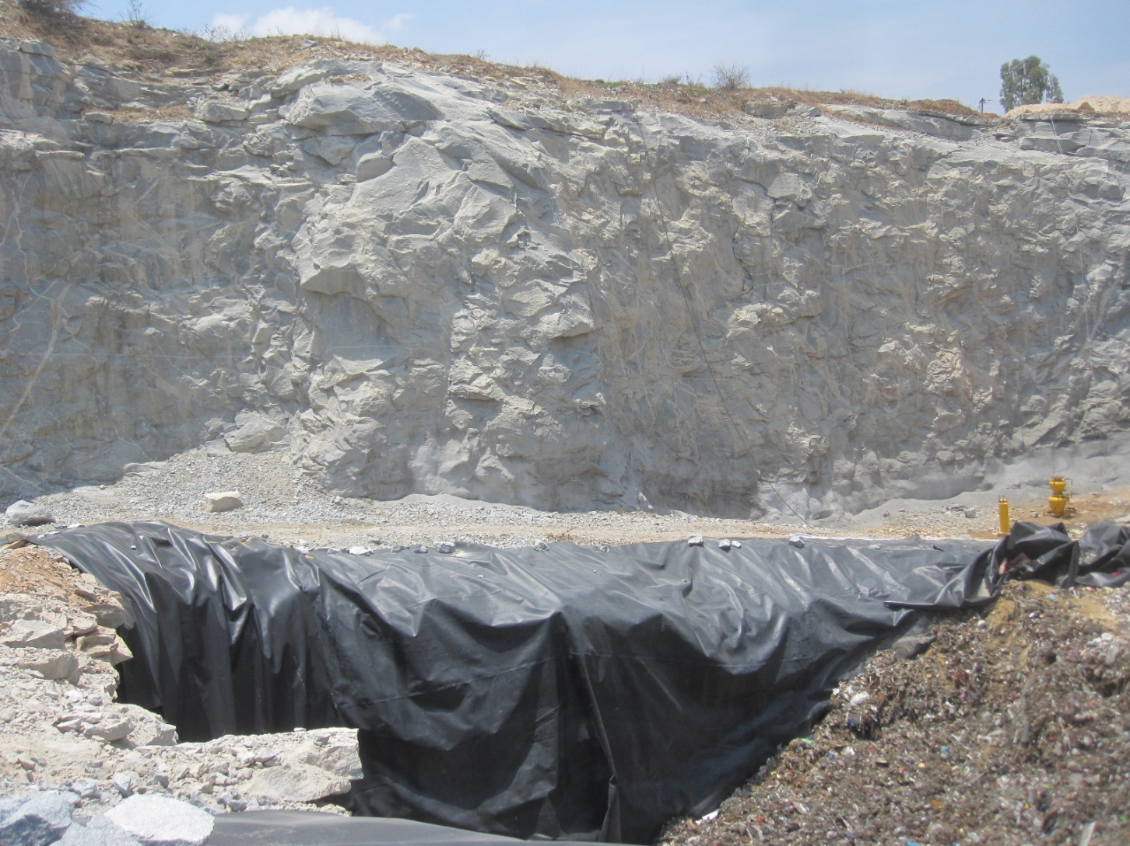
Plastic is also draped in deep pockets on the quarry floor.

Slide 12
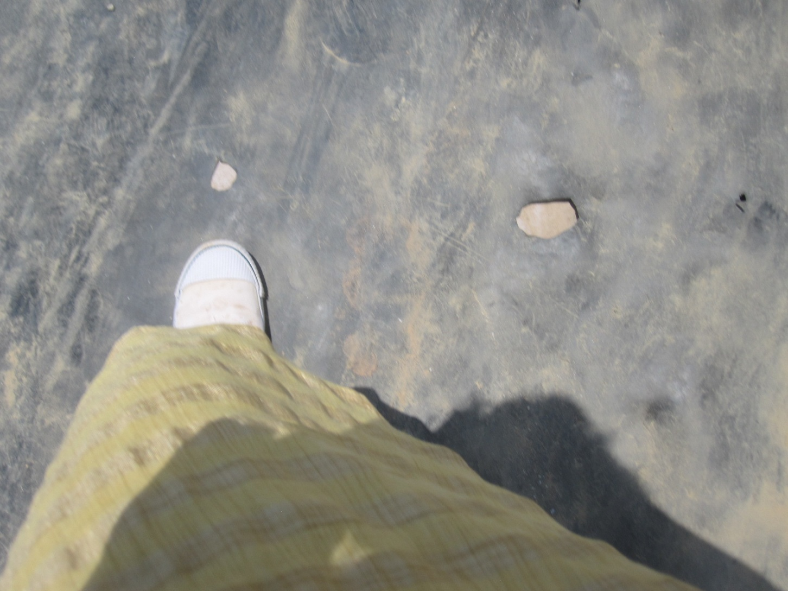
The weak plastic is easily punctured in many places, with some big holes

Slide 13
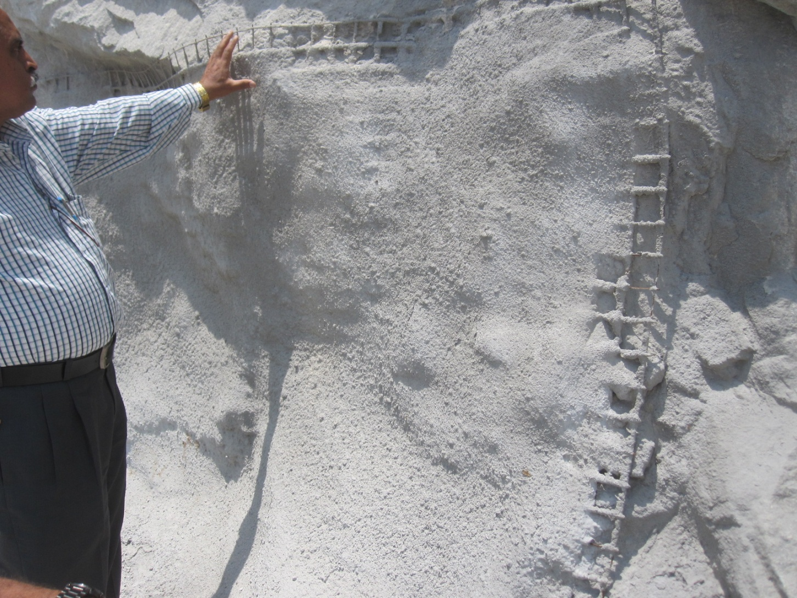
Shot-creting over weldmesh is being done along the bottom wall of the quarry

Slide 14
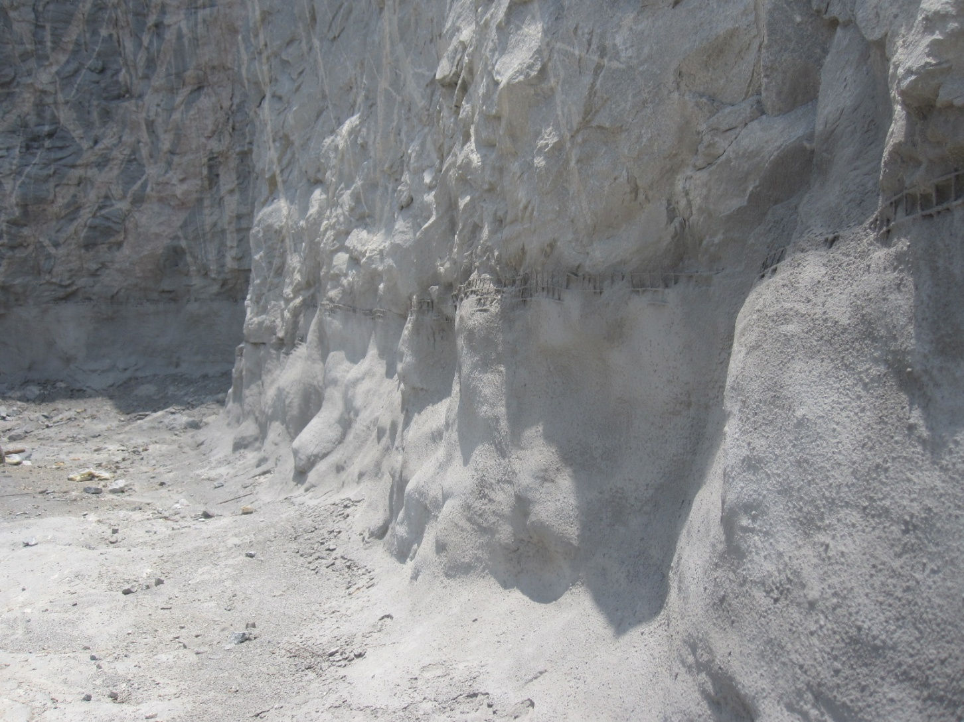
Continuously for a few feet

Slide 15
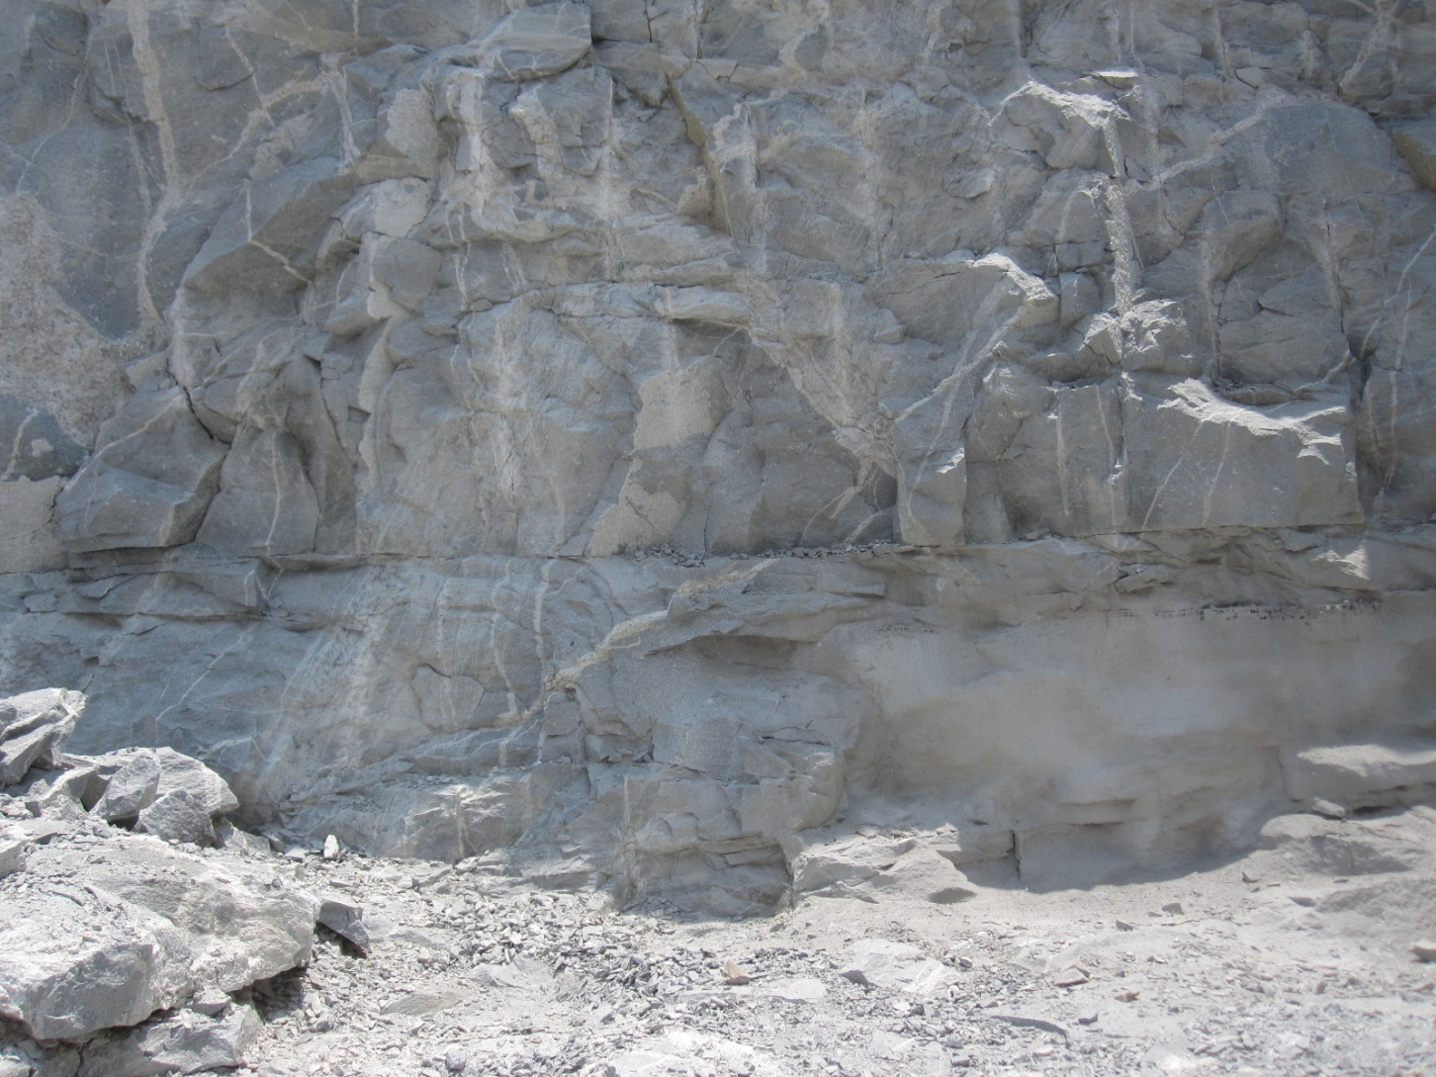
Without first removing fractured rock

Slide 16
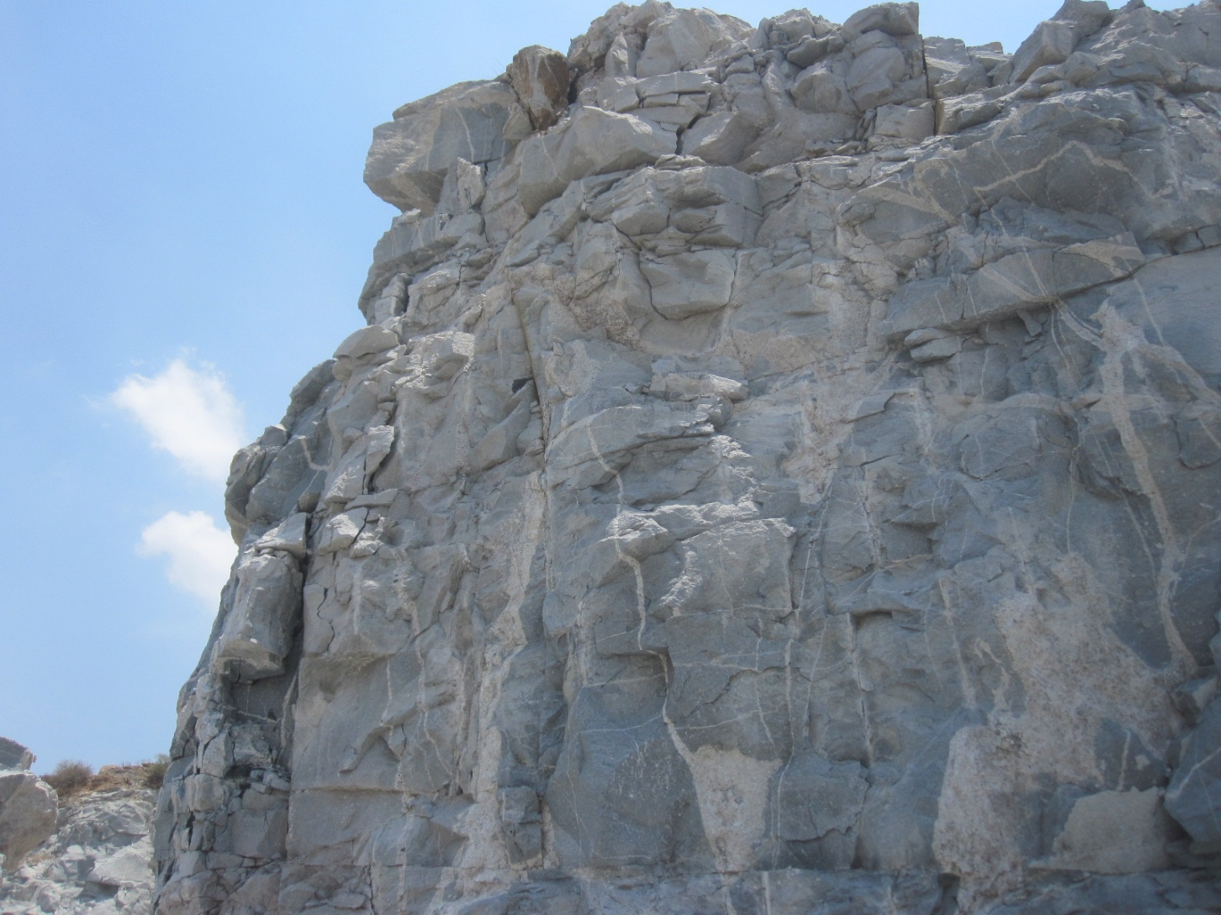
The loose upper rock is most dangerous

Slide 17
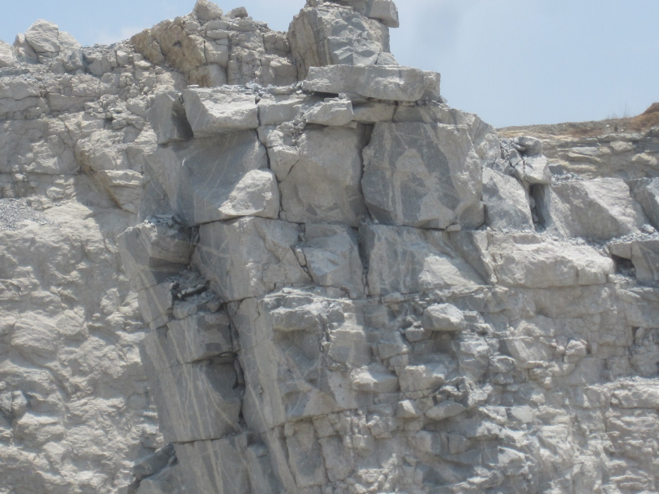
As fractured giant boulders

Slide 18
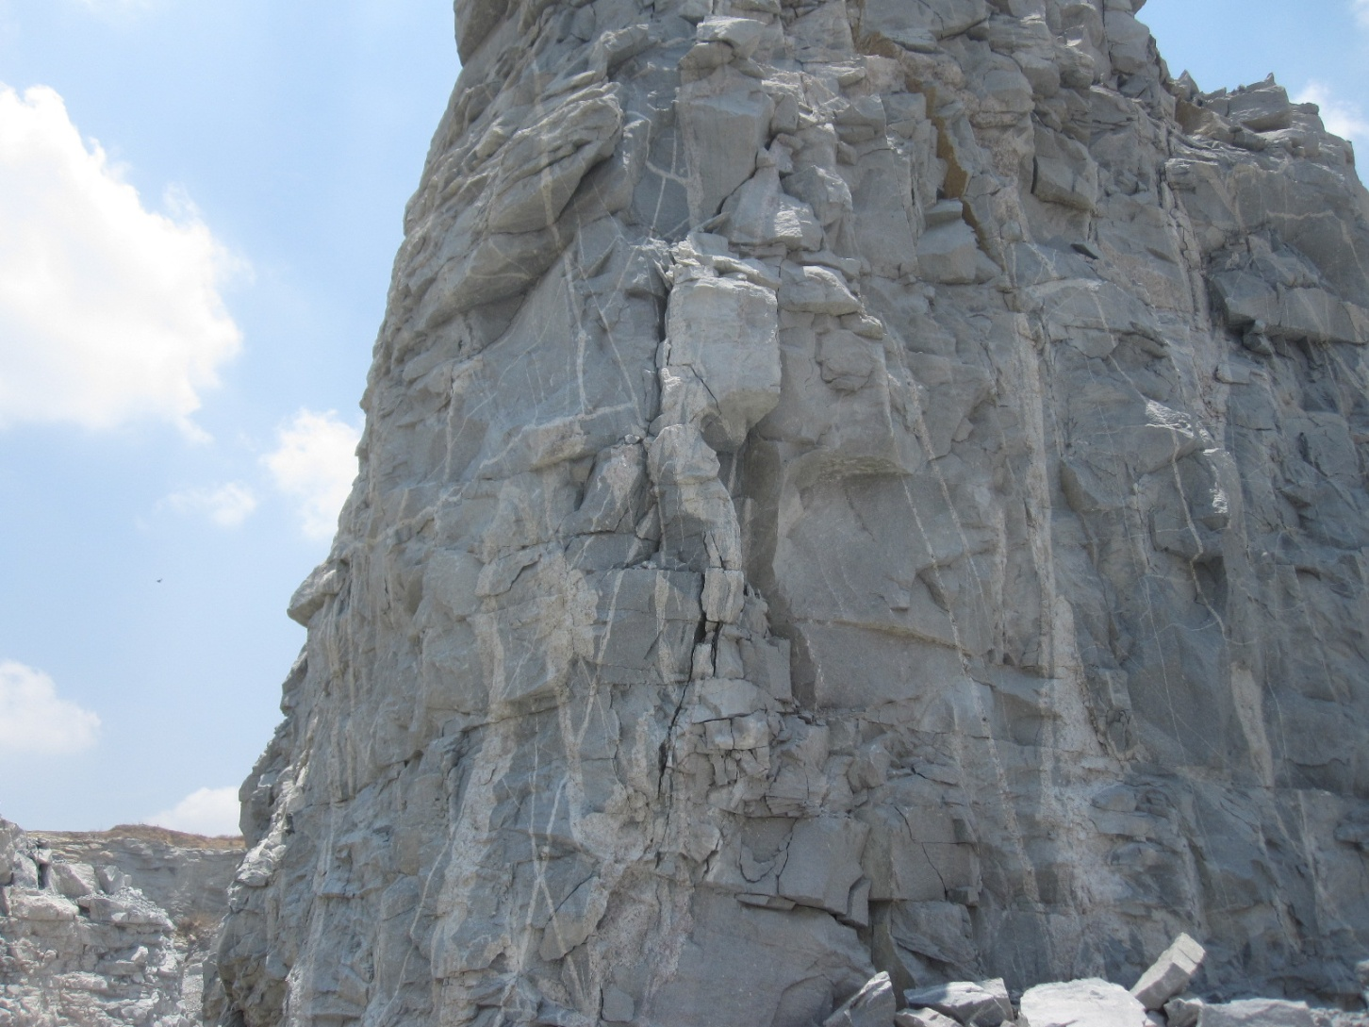
can fall any time

Slide 19
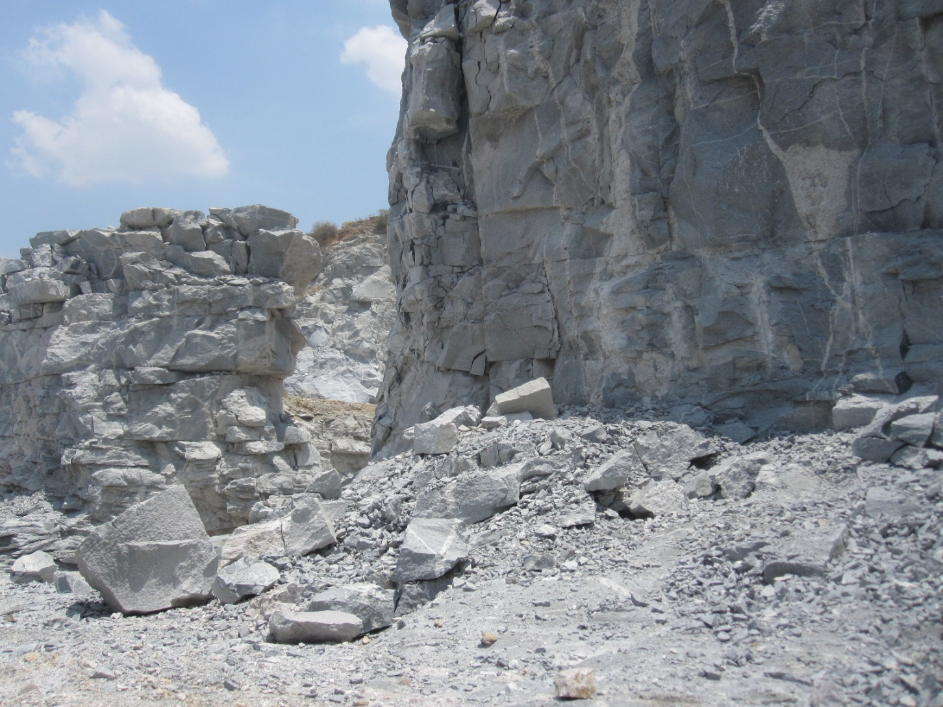
Rocks falling onto the quarry floor.

Slide 20
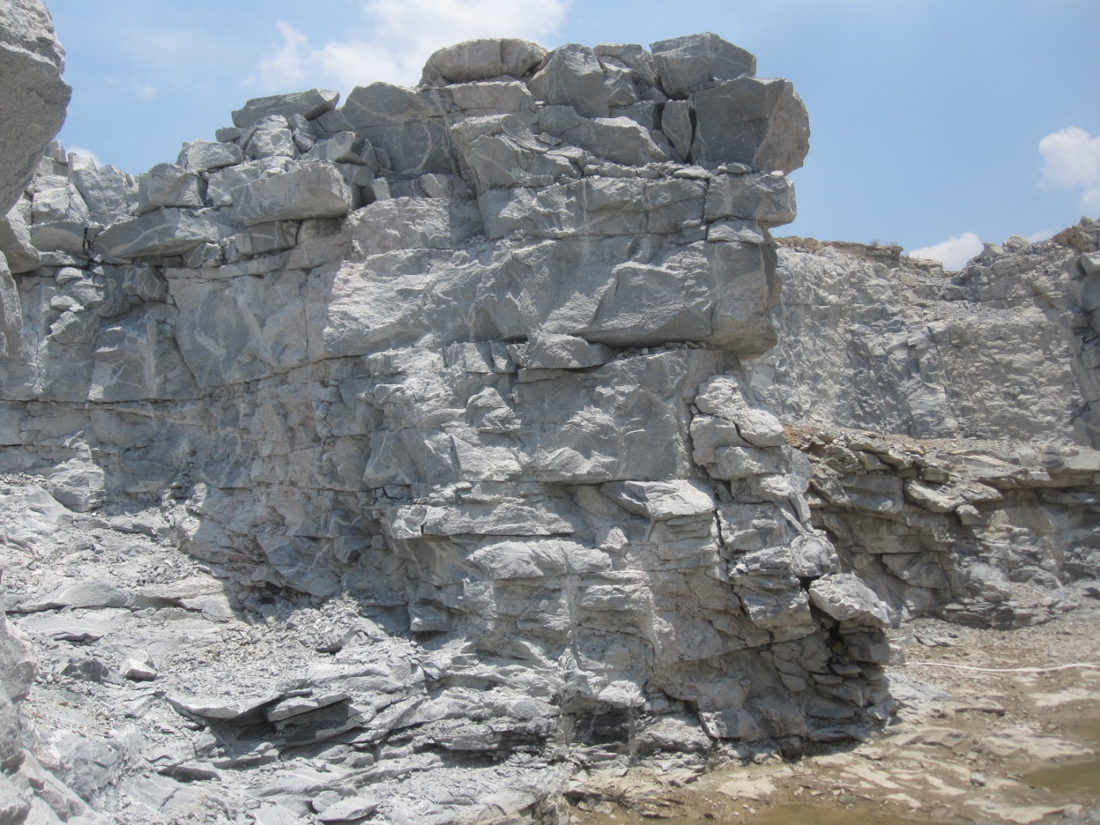
There are many dangerous overhangs

Slide 21
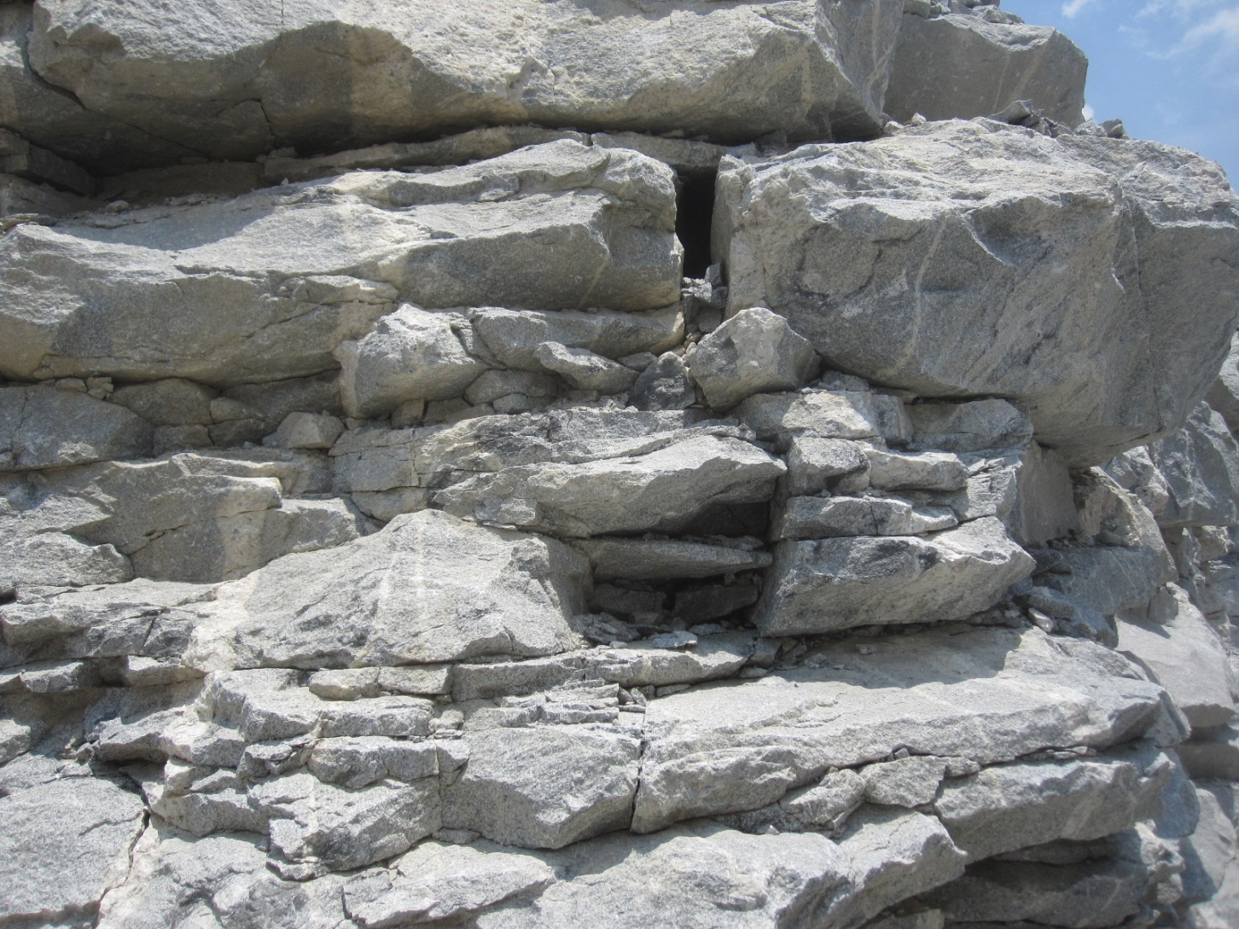
And faces of loose fractured rock

Slide 22
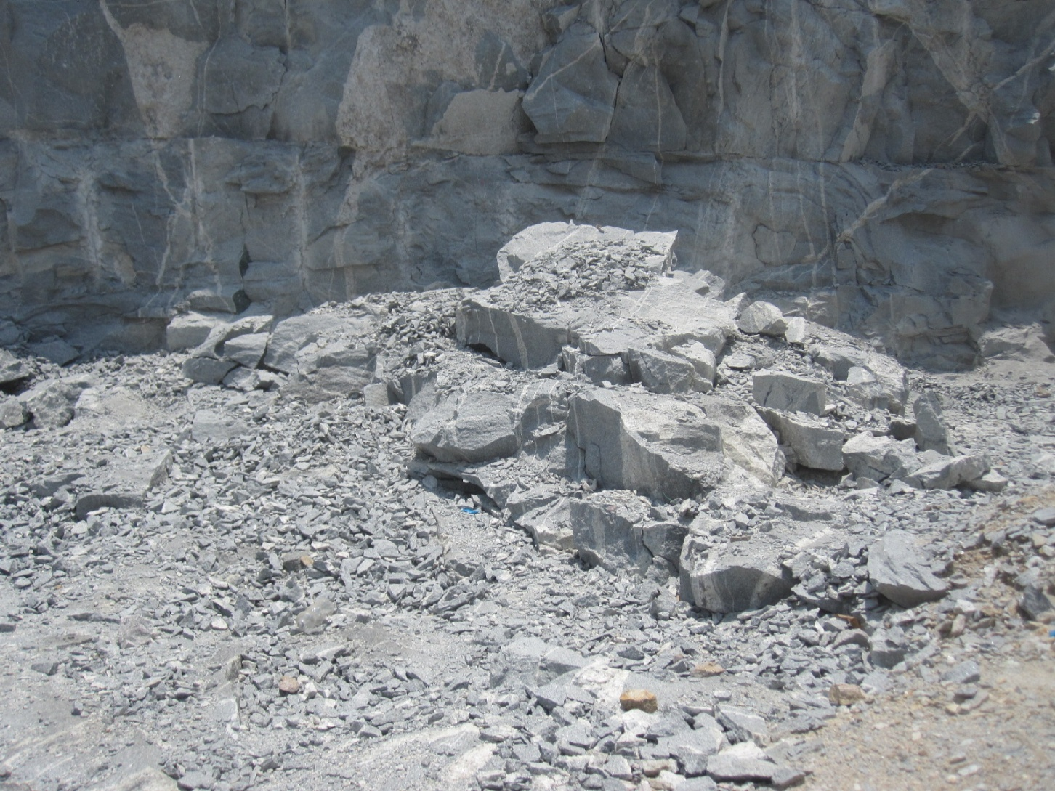
Fallen rock will create problems for effective waterproof lining of the quarry

Slide 23
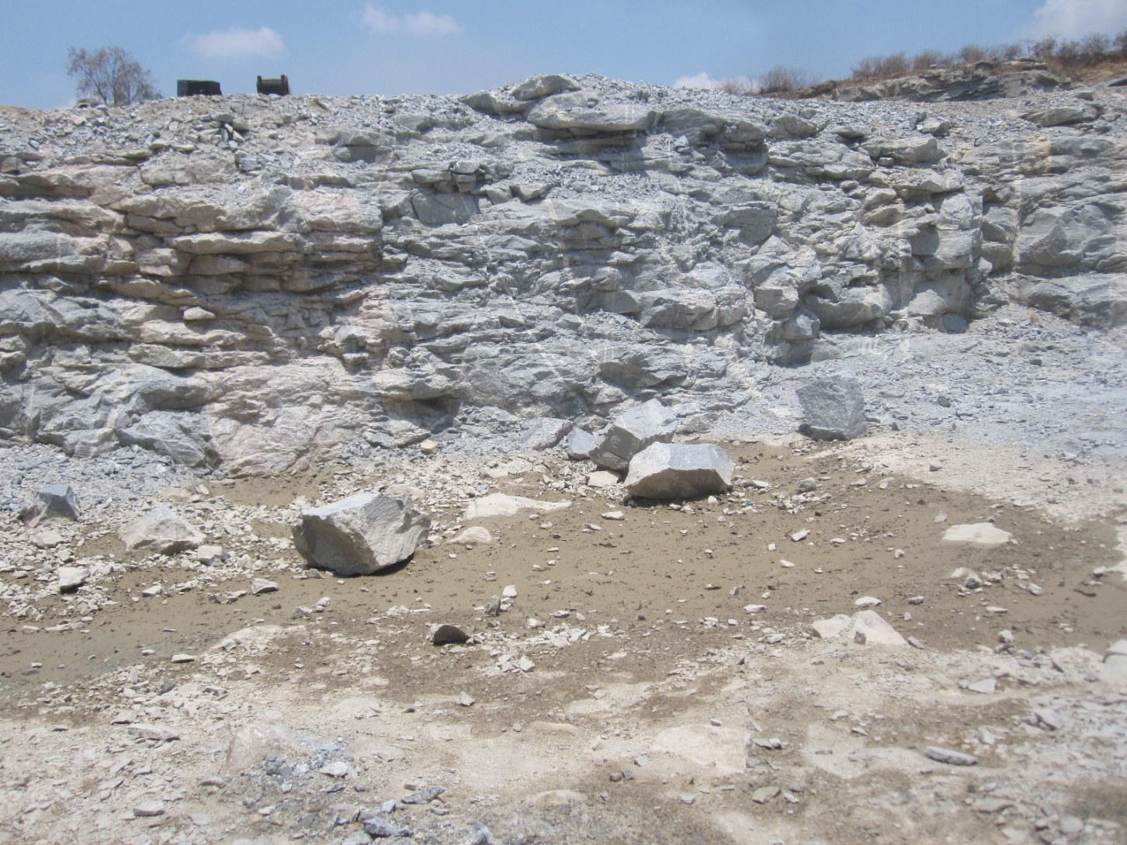
Loose rocks lying inside need removal

Slide 24
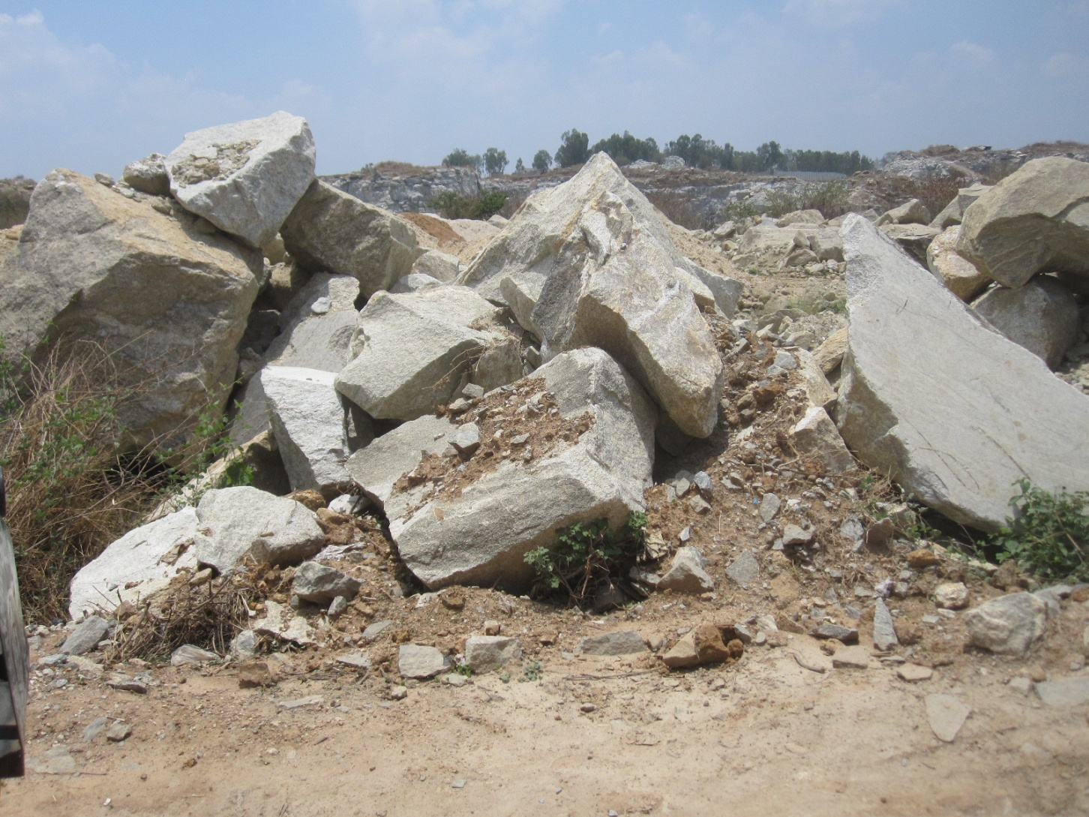
Rocks on the surface also need removal

Slide 25
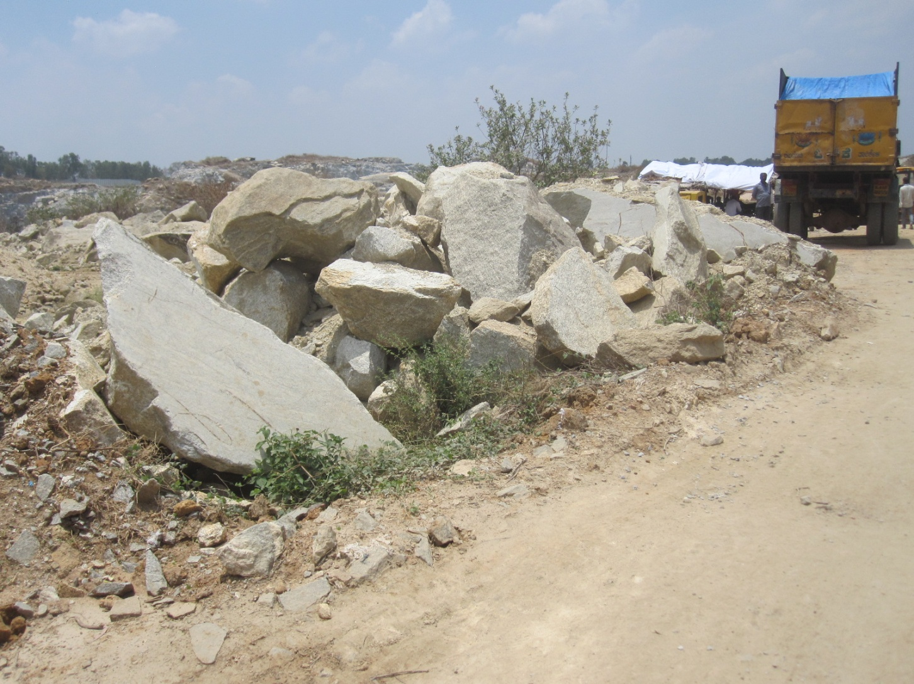
To improve access to the quarry

Slide 26
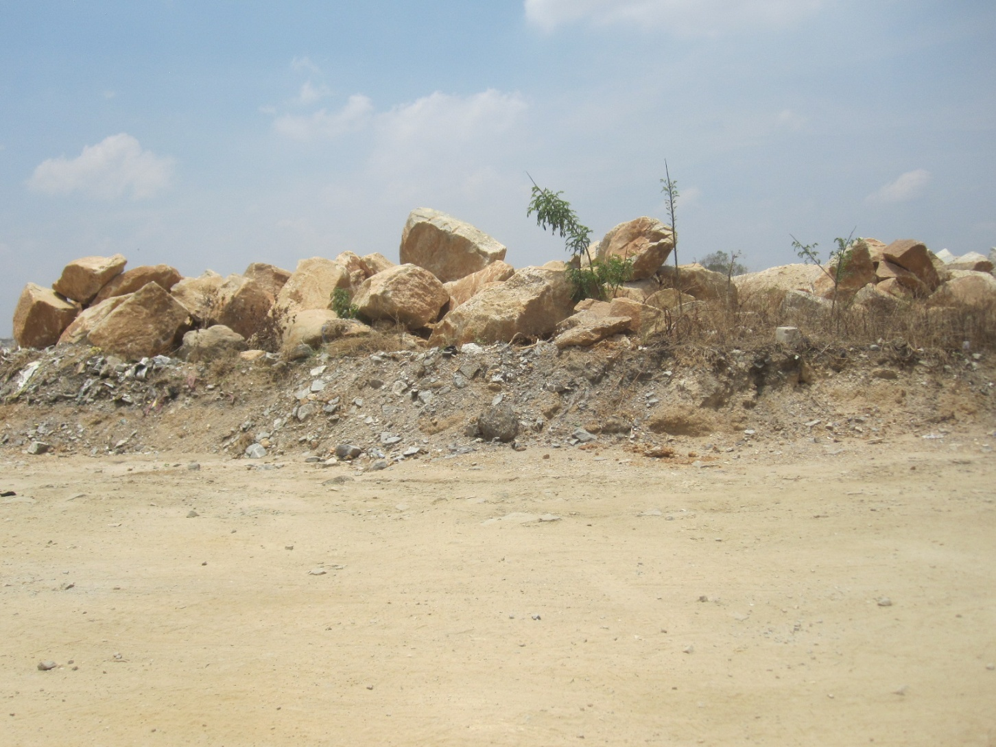
To widen the approach road

Slide 27
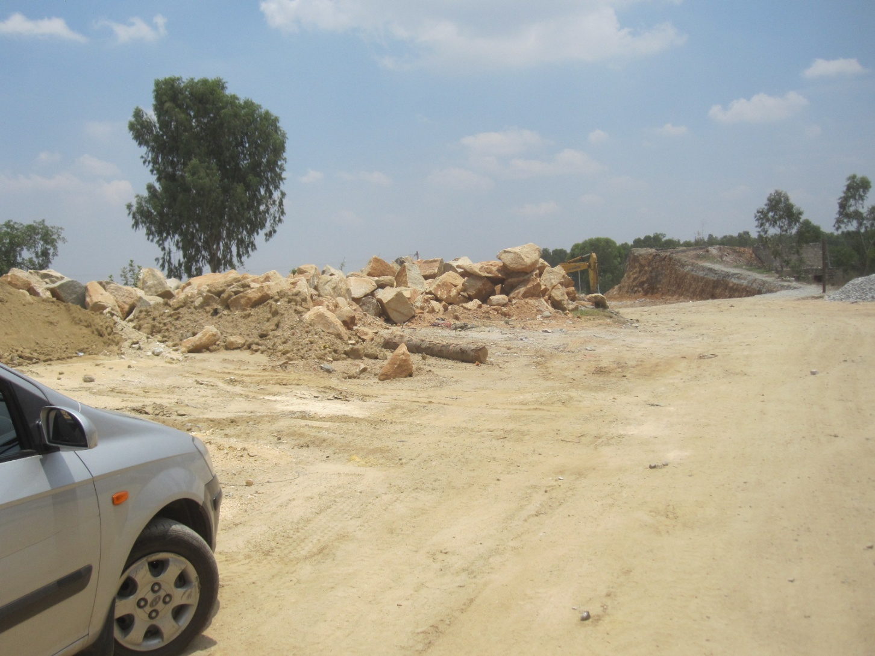
And create more open space

Slide 28
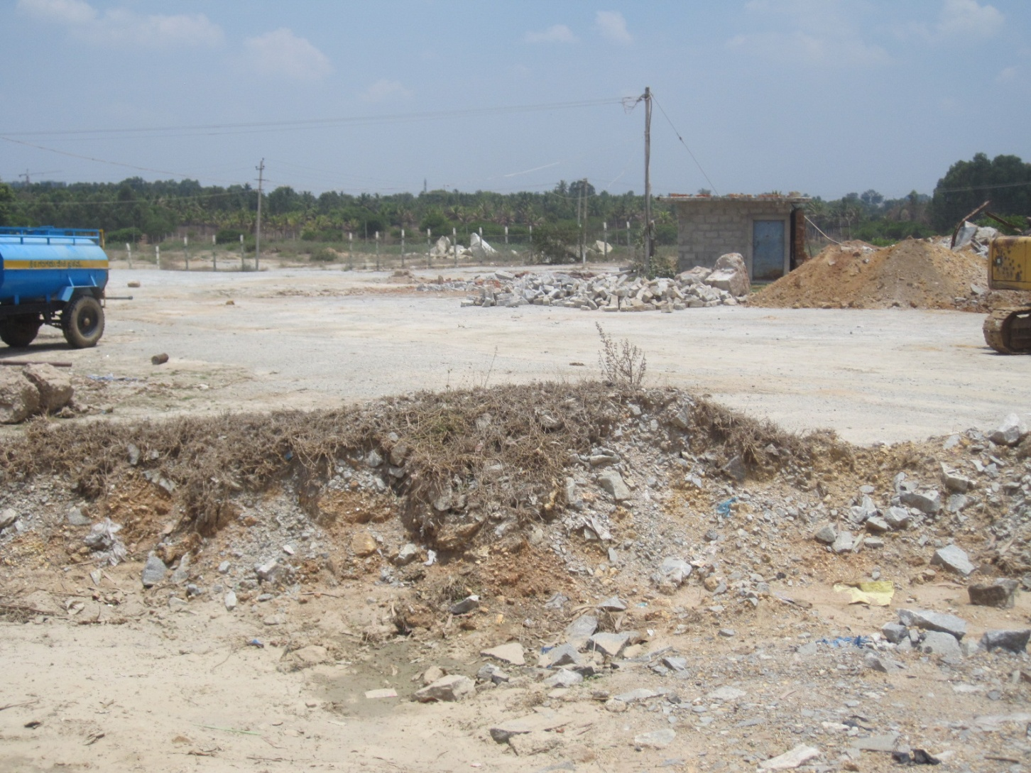
where mixed waste can be stabilised in windrows before filling into the quarry.

Slide 29
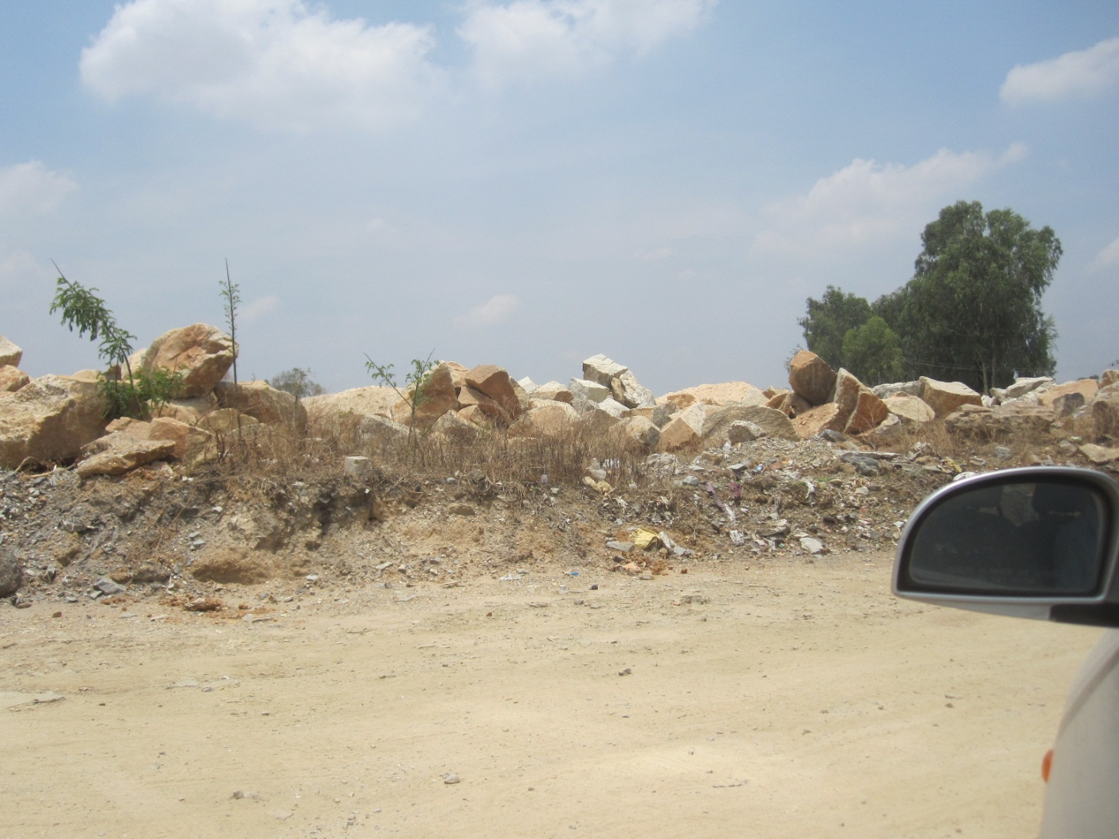
The existing crusher should be given temporary permission to operate for another 6-12 months to clear all this.

Slide 30
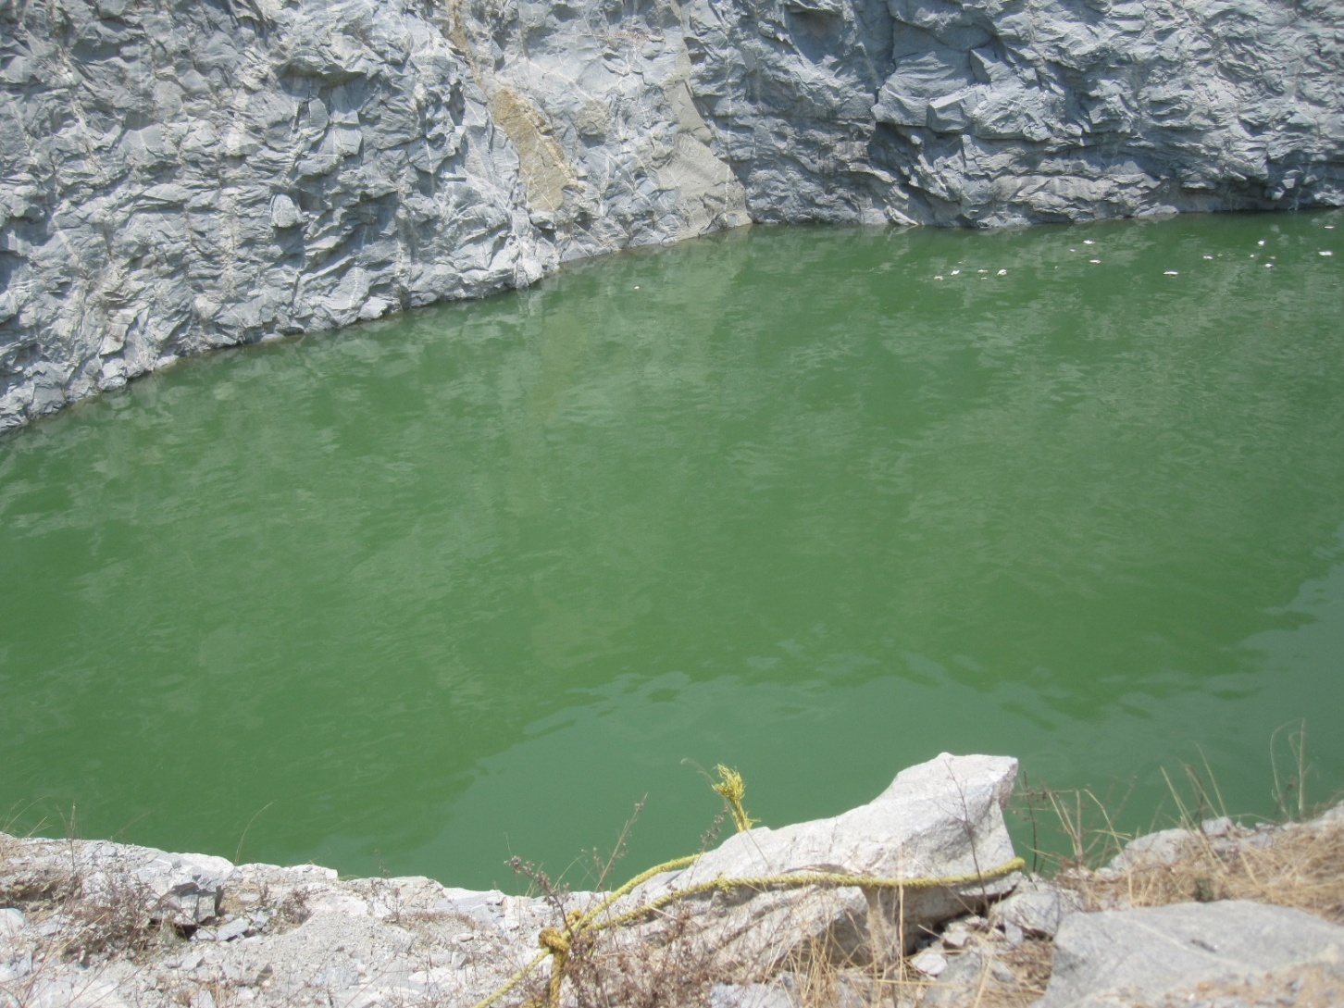
There is an existing pool 60ft deep (measured) unused by locals

Slide 31
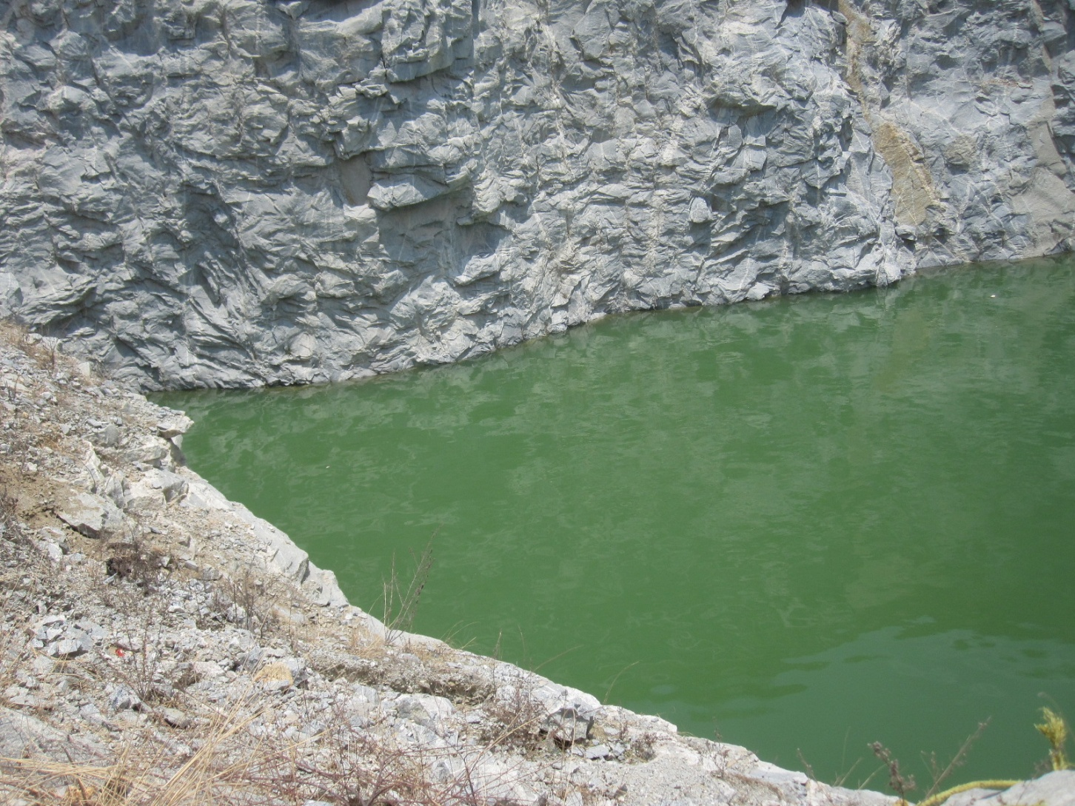
which is tempting for summer swimmers who drown here.

Slide 32
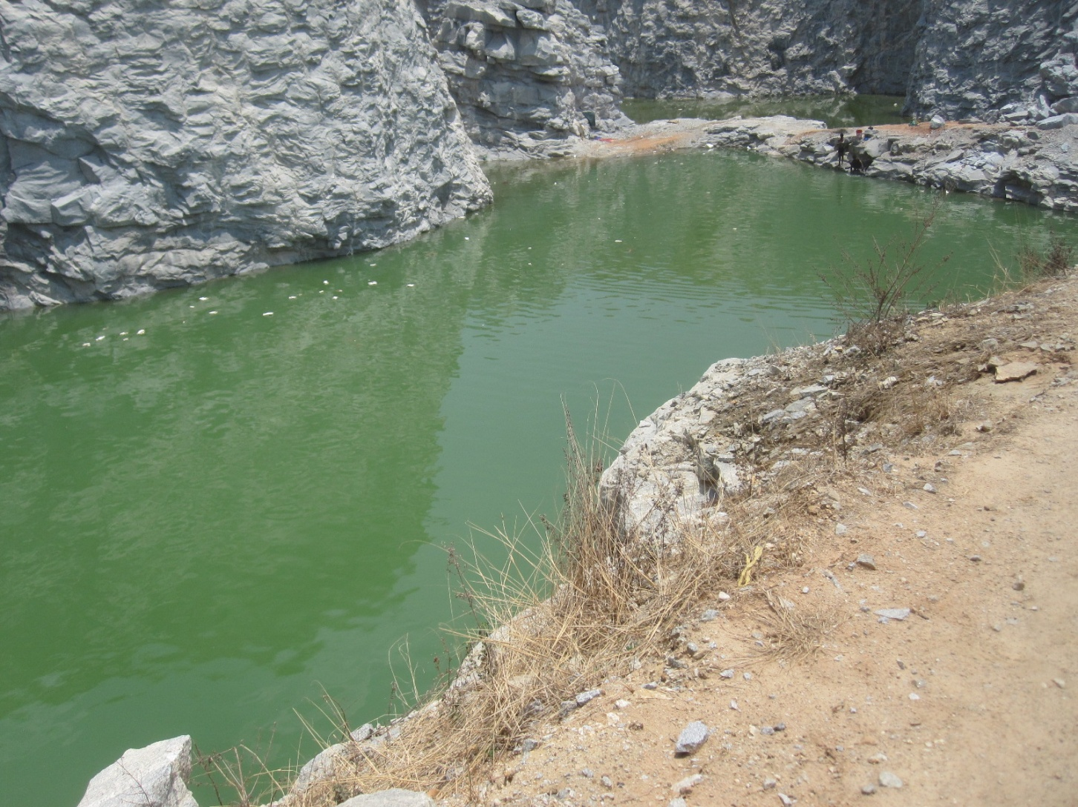
This pit is clearly waterproof and needs no lining upto the waterline.

Slide 33
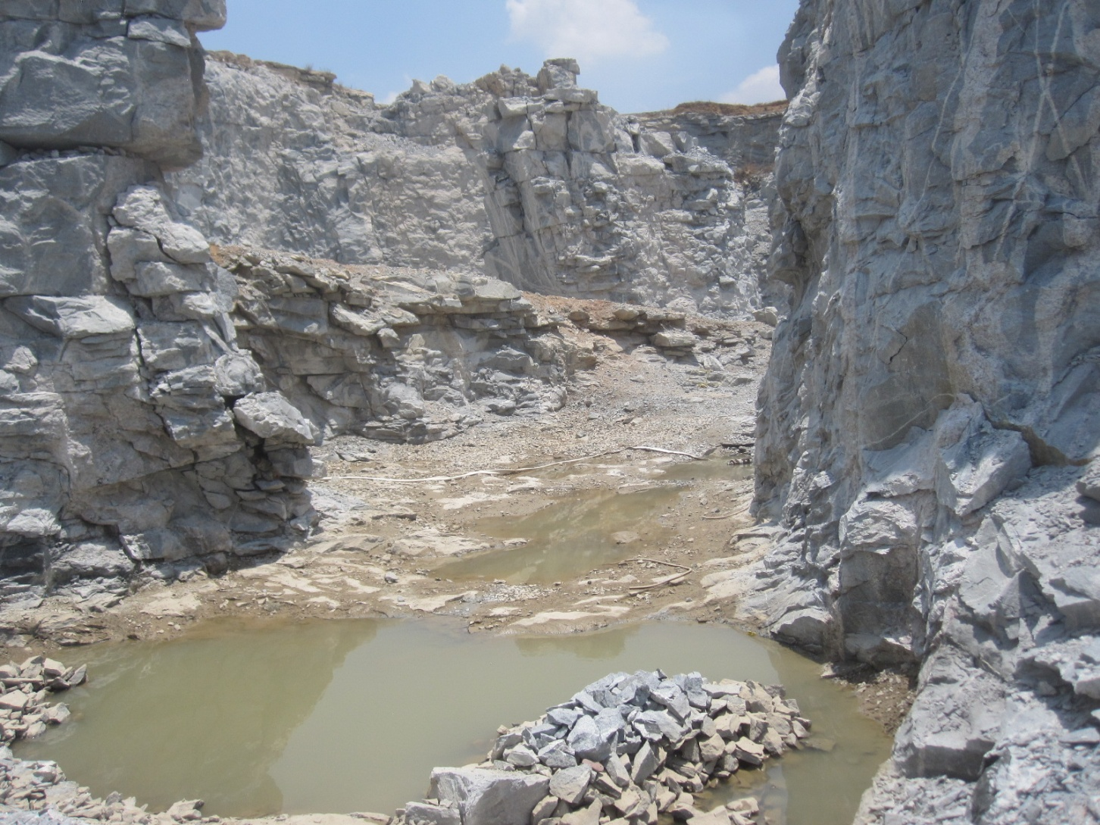
The deep pool if needed can be drained into this porous pit with no pollution.

